Slide 1
Product Review Report Product: Google Maps
NAME:PAVIVARCHINI
DEPARTMENT:CCE
REGISTER NUMBER:922525118039

Slide 2
Introduction Google Maps is a navigation and mapping application developed by Google. It helps users find locations, directions, and nearby places. It is widely used for travel and navigation.

Slide 3
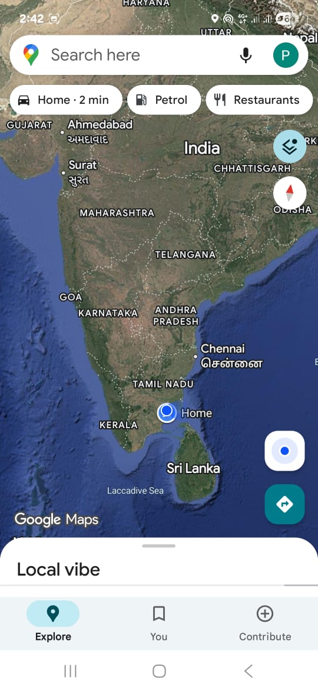
Purpose of the App The main purpose of Google Maps is : To find locations easily To provide navigation and directions To show nearby places like hotels, hospitals, and shops To help users travel safely and quickly

Slide 4
Key Features Important features of Google Maps: GPS navigation Real-time traffic updates Location search Street view Nearby places suggestions

Slide 5
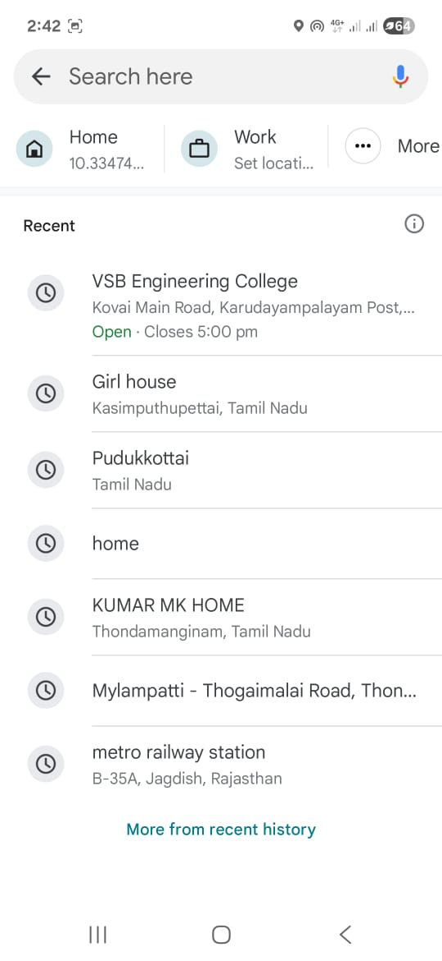
Usage Analysis Users can: Search for any location Get driving, walking, or bus directions Check traffic conditions Save favorite locations

Slide 6
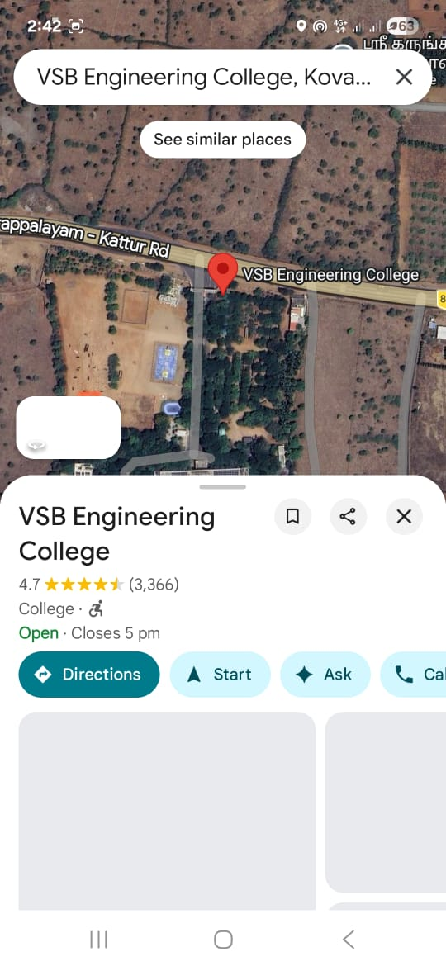
Benefits Benefit of using Google Maps: Easy to use Accurate directions Saves time while traveling Helpful for tourists and drivers

Slide 7
Advantages & Limitations Advantages Free to use Real-time navigation Available on most smartphones Limitations Requires internet connection Consumes phone battery Sometimes GPS may be inaccurate

Slide 8
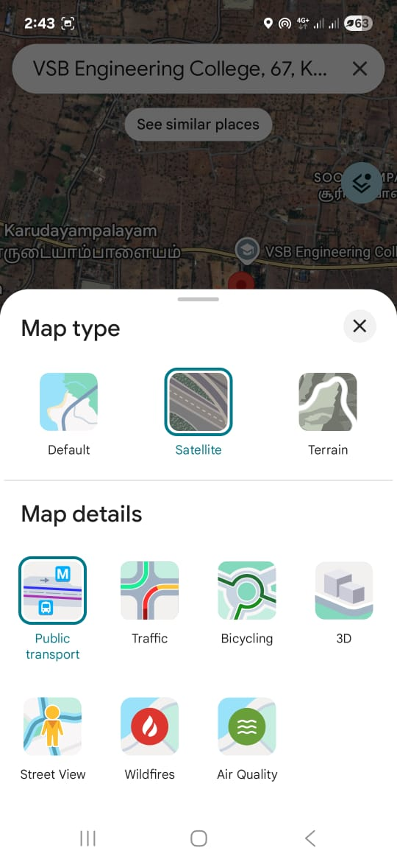
Data Insights Used by millions of people worldwide Available on Android and iOS Regular updates improve accuracy and features

Slide 9
Conclusion Overall, Google Maps is a very useful navigation app. It helps users find places quickly and travel easily. Rating: ⭐⭐⭐⭐ 4/5 Recommendation: Best for travelers, drivers, and daily commuters.

